Slide 1
Build a business website for programming books

Slide 2
HELLO!
+ GROUP :
- LEADER: NGUYEN VAN LAN 20IT160
- MEMBER: TRAN DINH HIEU 20IT691
Instructors : THS.Vo Ngoc Dat

Slide 3
Reasons for choosing the topic
1
- In production and business activities, now e-commerce has affirmed its role in promoting and promoting the development of enterprises. For a store or company, it is necessary to promote and introduce to customers new products that meet the needs of customers. So how to promote that is to build a Website for your store. Therefore, I have implemented the project "BUILDING BUSINESS WEBSITE OF PROGRAMMING" to promote all of my products for sale.

Slide 4
Header target
2
- Research and learn the process of building a business website.
- Apply those who know, already know, and learn more to build websites.
- Use back-end, front-end techniques and languages ​​like PHP, HTML, CSS, Java Script to create the website and use PHPMyadmin to store the website's data.
- Especially, we also use the Laravel framework to build websites according to the MVC model.

Slide 5
Research Methods
3
- Combination of theoretical research and understanding of practical needs of people. At the same time, experience and refer to current online business websites.On that basis, we have built a website for trading programming books with full basic functions.

Slide 6
Operation description
4
Websites are created in languages ​​(HTML, CSS, PHP, JavaScript, MVC Models (Model, View, Controller), PHPMyAdmin).

Slide 7
DESCRIBE WEBSITE

Slide 8


Slide 9
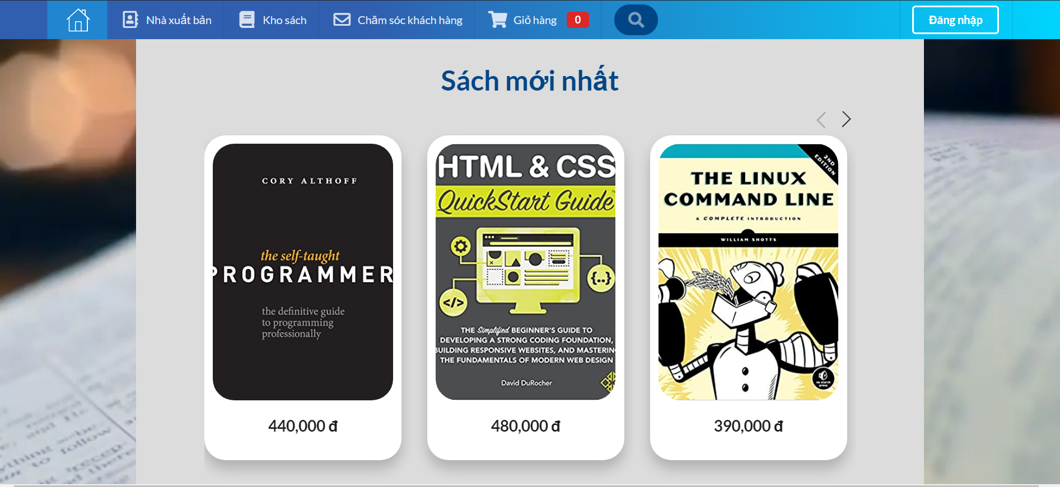

Slide 10


Slide 11
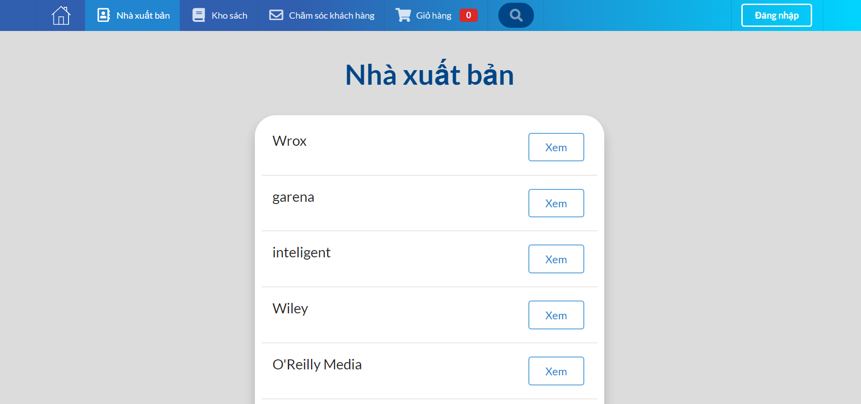

Slide 12
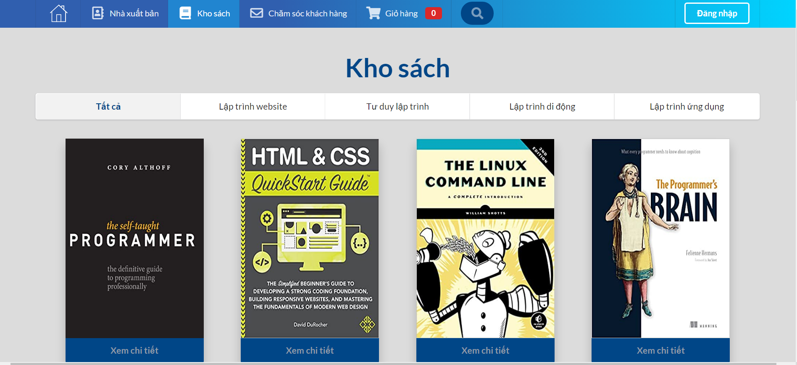

Slide 13
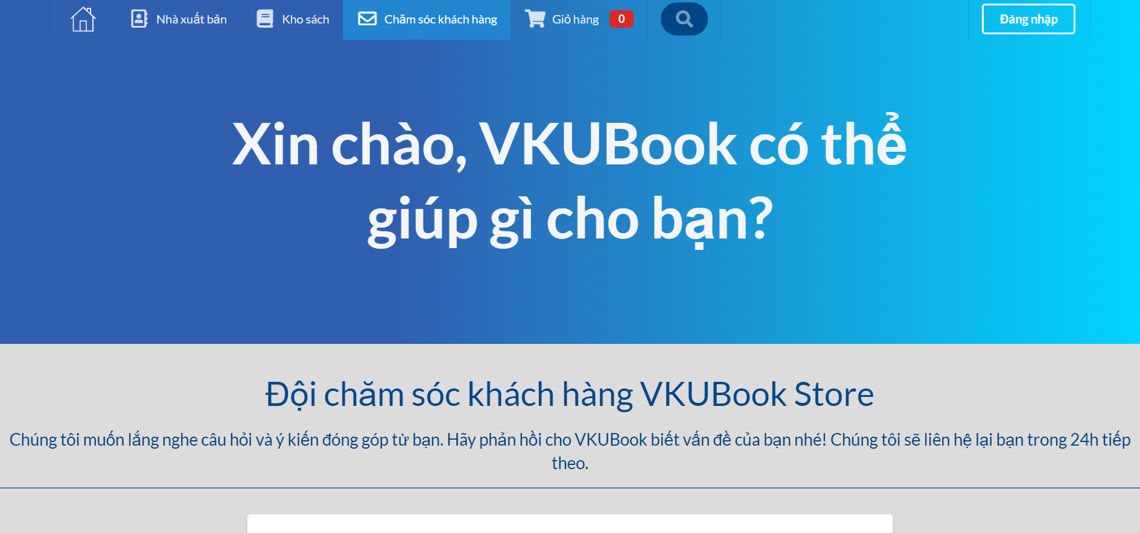

Slide 14
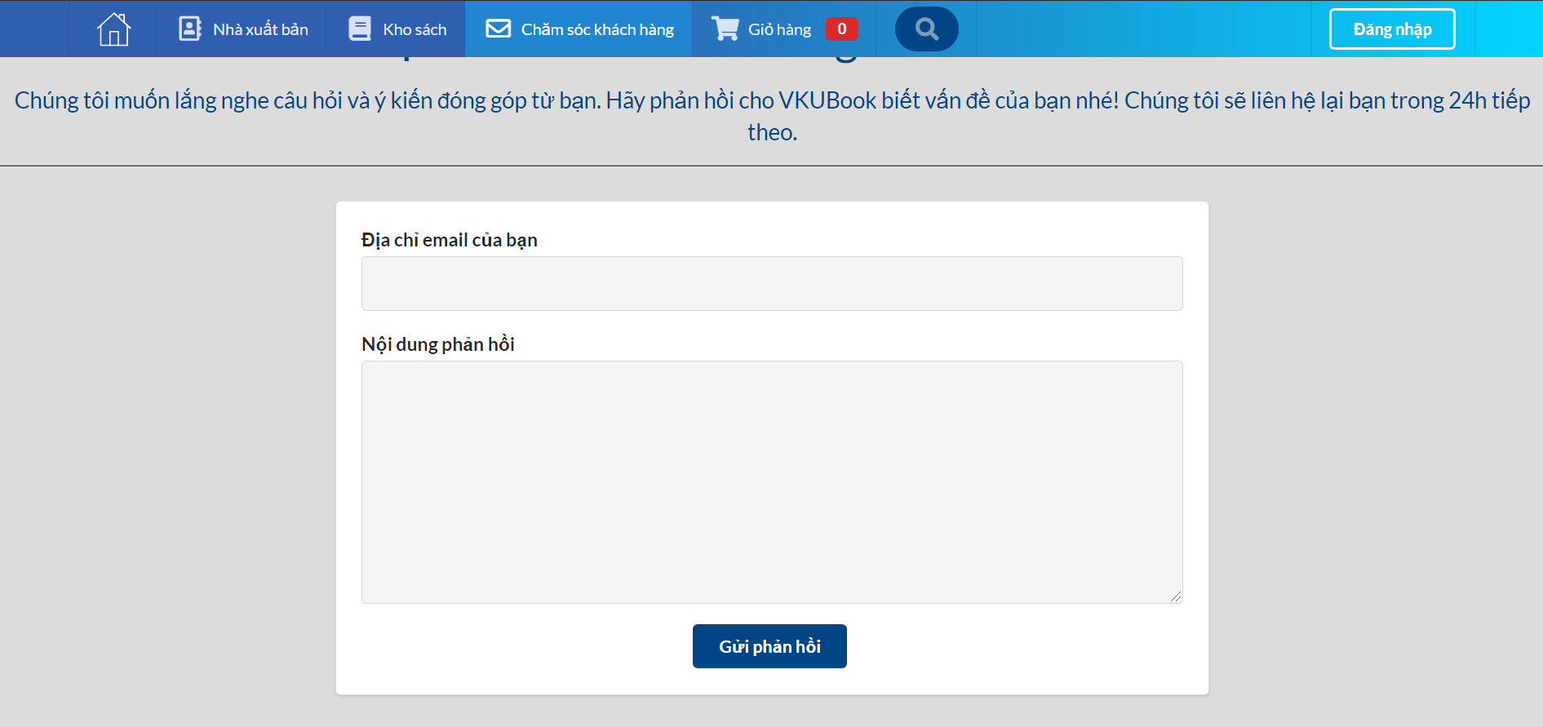

Slide 15
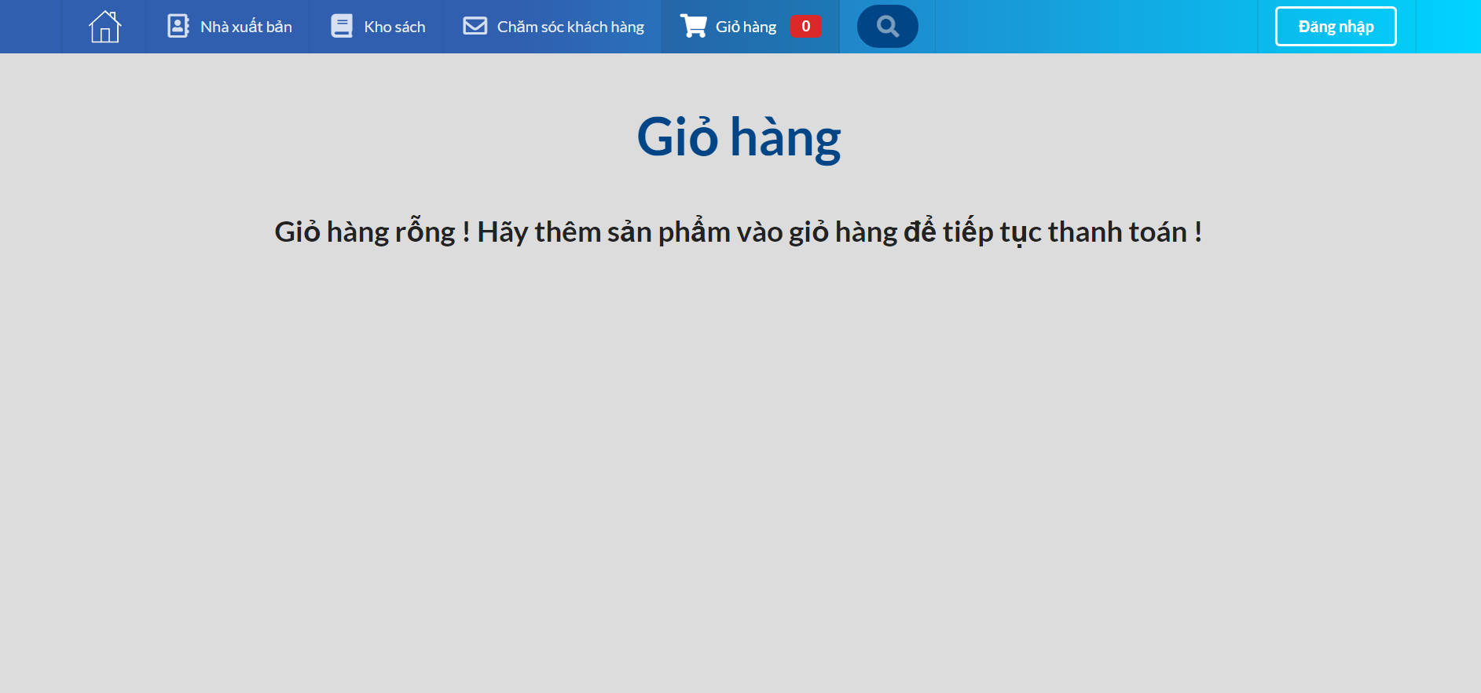

Slide 16
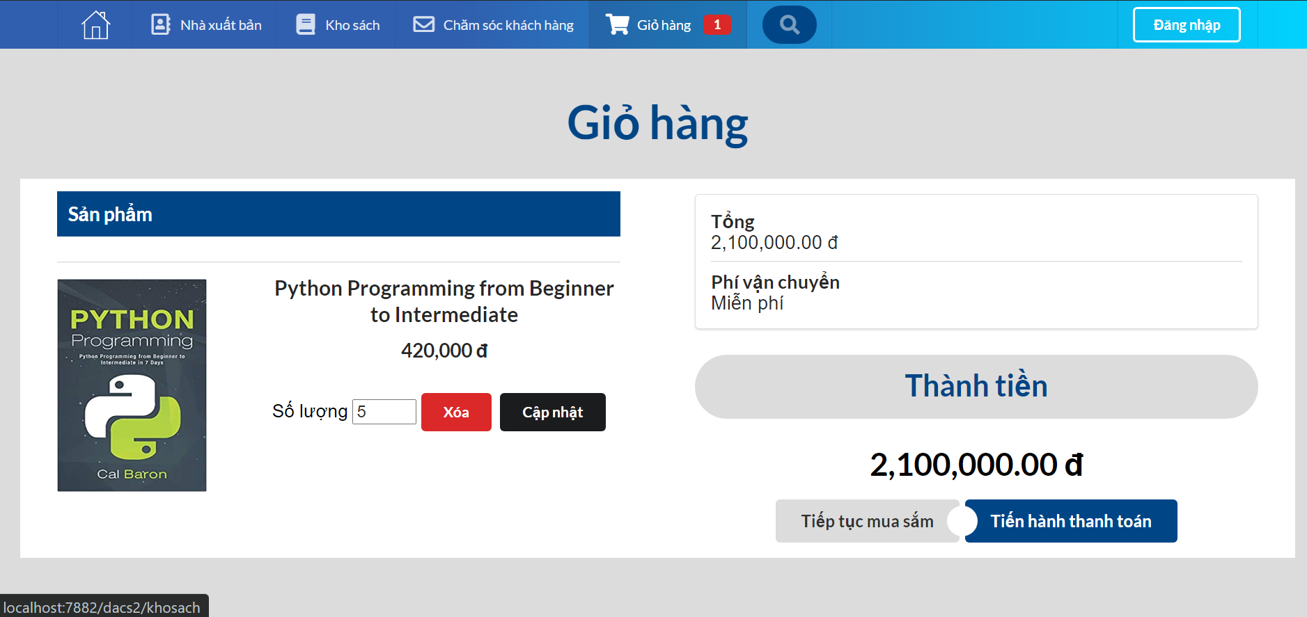

Slide 17
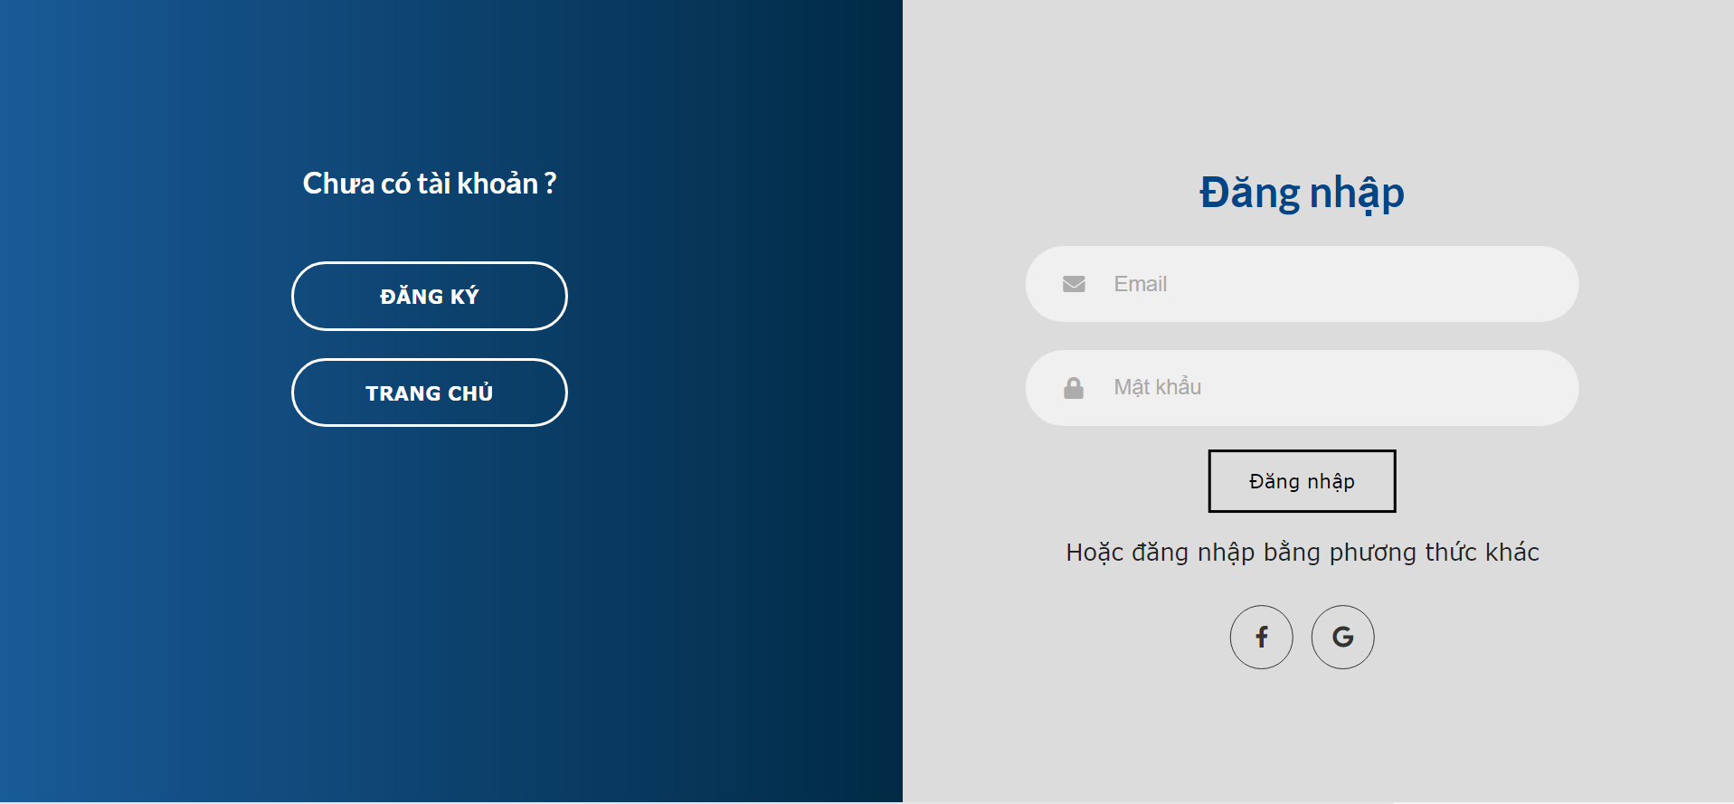

Slide 18
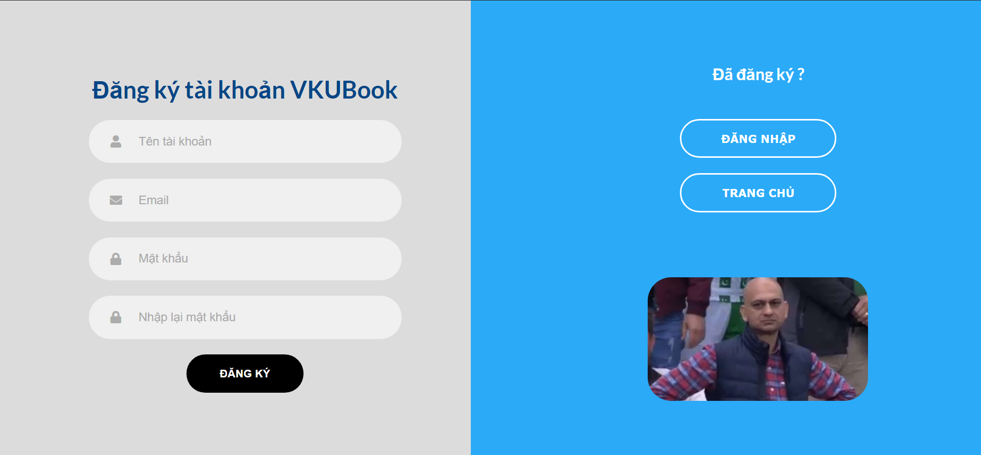

Slide 19
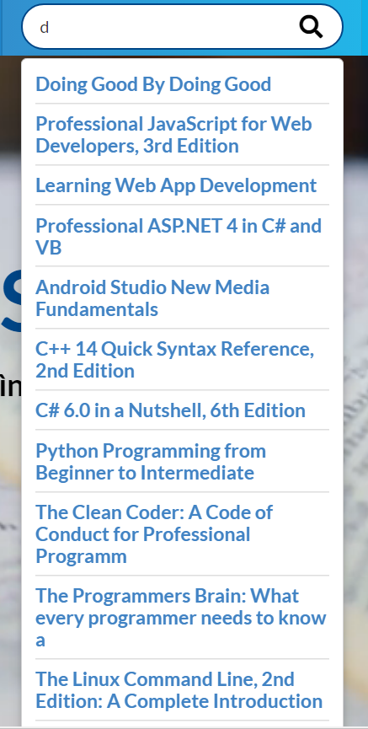

Slide 20
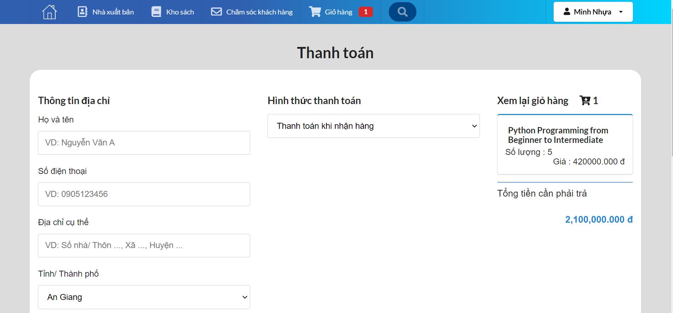

Slide 21
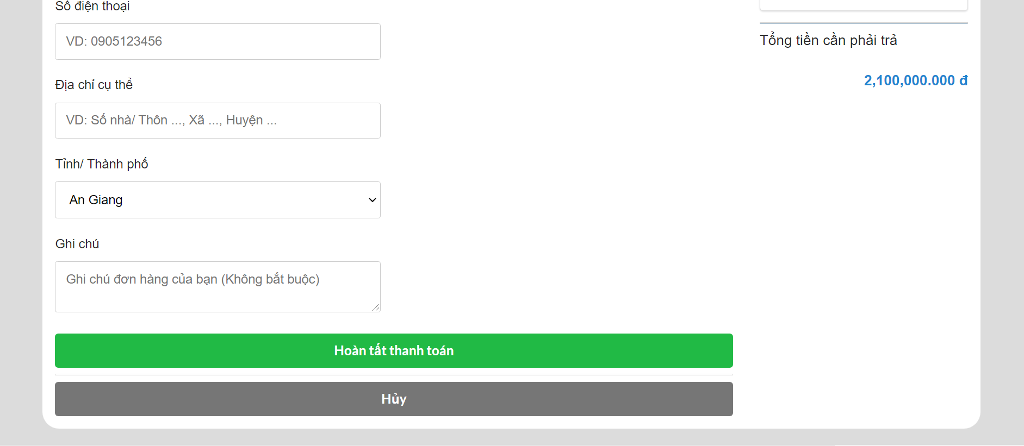

Slide 22
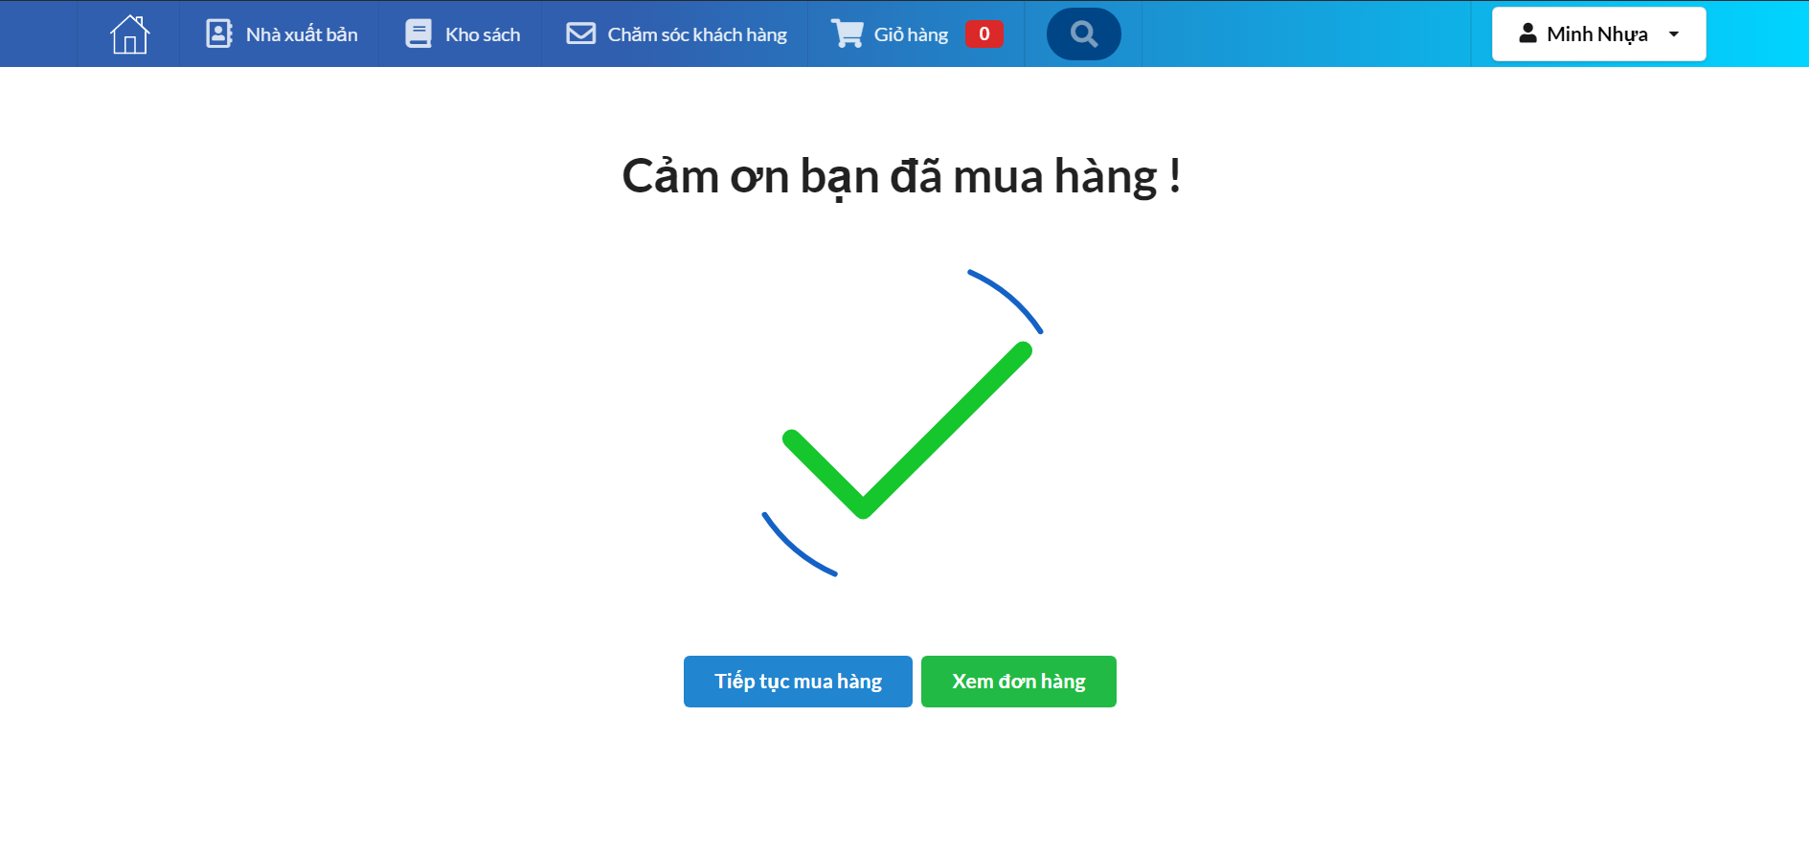

Slide 23
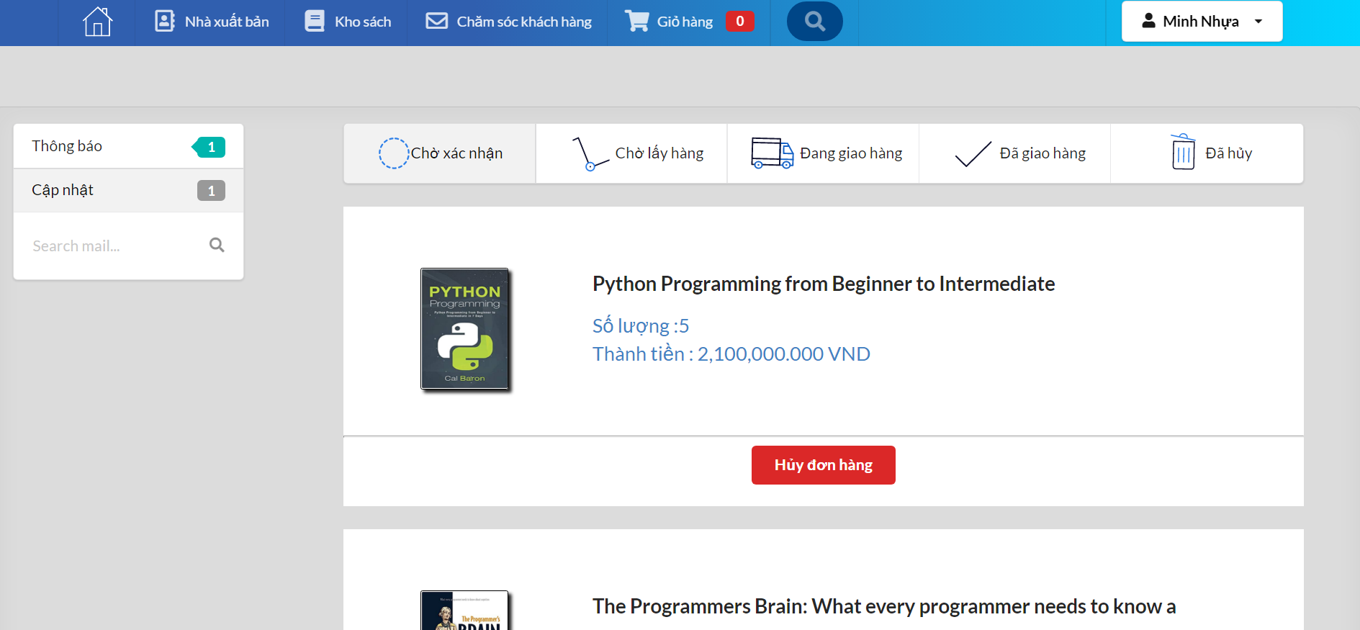

Slide 24
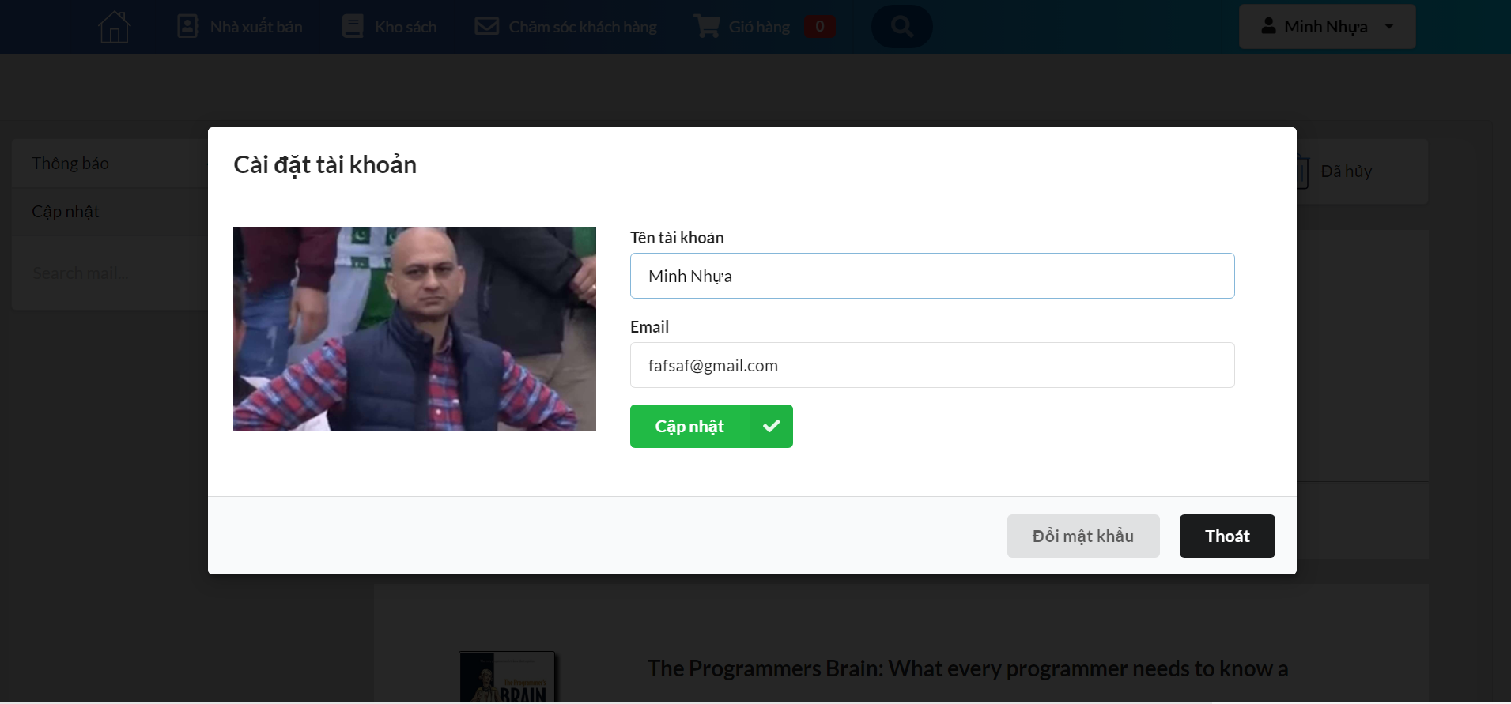

Slide 25
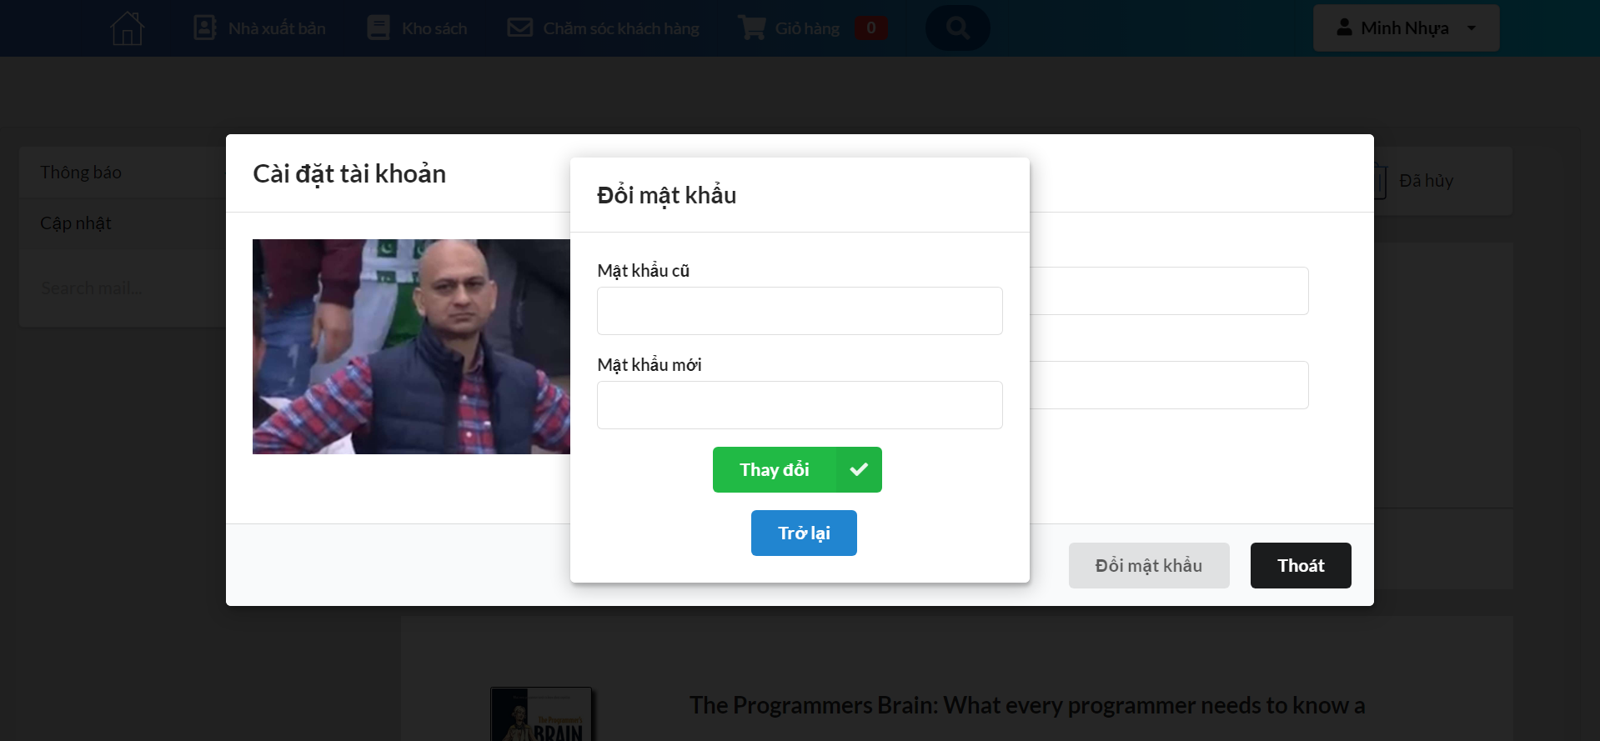

Slide 26
THANKS!
ANY QUESTIONS?

